Slide 1
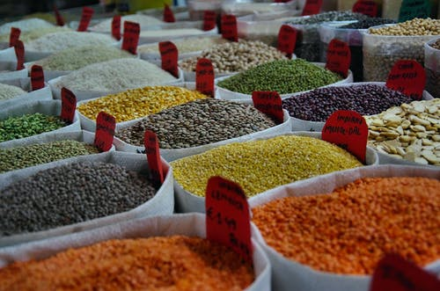
The Effects of Global Warming on Global Grain Supply
Team Advisor: Dr. Helen Gu
Team Members:
- Jason Ortiz
- Rhodiam Arango
- Daniel Cohen

Slide 2
Solution Process
Model Interpretation
Recommendation
Our
Data
Model Comparisons
Key
Insights
Problem Overview
Countries and their Food Supplies are more interconnected than ever

Slide 3
Problem Overview
How will Climate Change affect grain production and food supply?
Which countries would be at risk of changes to food supply shortages from increased temperatures?
Hypothesis: If Climate Change is not properly addressed then poorer countries will be at risk due to over reliance on technologically advanced countries for food.
Notes:
(Less GDP/Population) -> less CO2 output -> less technologically advanced -> leads to over reliance on technologically advanced countries for food)

Slide 4
Objectives
Use Machine Learning & Data Mining models and techniques to analyze and visualize very large datasets to find new patterns and reinforce expected patterns regarding Climate Change and Global agricultural data.
Using the reinforced patterns, alongside the new patterns that have been discovered within the data, make some conclusions on how climate change will impact the global grain supply.

Slide 5
Our Original Data
The initial datasets we gathered:
Weather Dataset - Berkeley Earth
Country/C02 Dataset – Our World In Data (OWID)
Agriculture Dataset - USDA Foreign Agriculture Service
Country Location Dataset - Google Developers

Slide 6
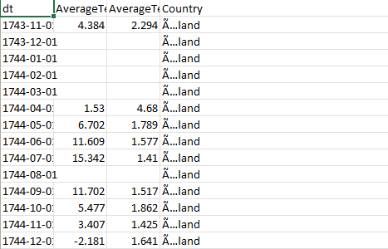
Berkley Weather Dataset
This dataset was composed of:
577,462 rows
And only 4 Attributes, those being:
Country
Date-Time
Average Temperature
Average Temperature Uncertainty

Slide 7
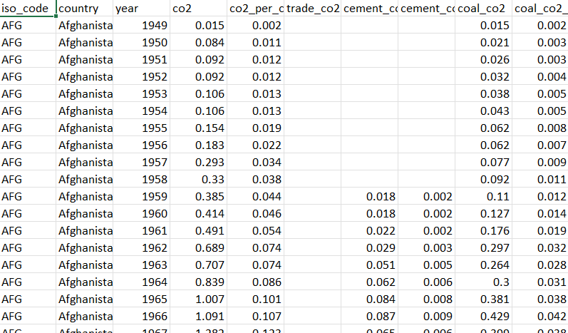
Our World In Data – CO2 Dataset
This dataset was composed of:
25,192 rows
And 60 Attributes, notable ones include:
Country
Year
Multiple Types of CO2
Total Green House Gases
GDP and Population

Slide 8
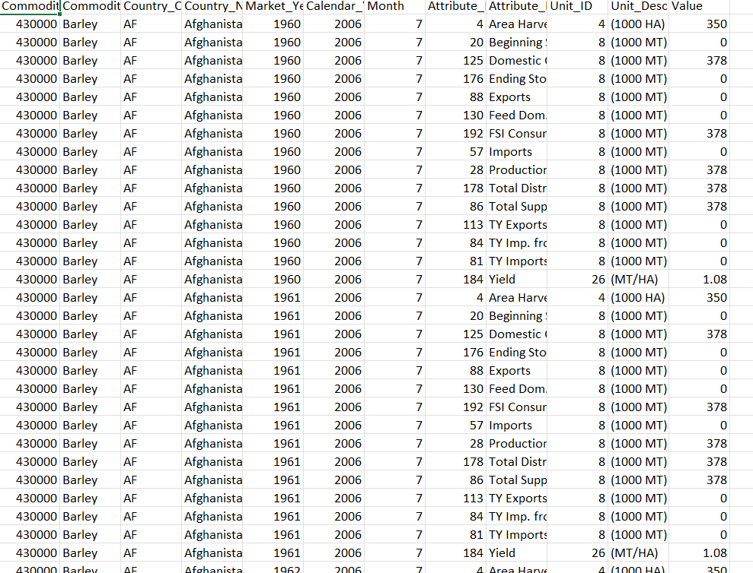
PSD Grains Pulses Dataset
This dataset was composed of:
535,320 rows
And 12 Attributes, notable ones include:
Country
Market Year
Attribute Description
Unit Description
Value

Slide 9
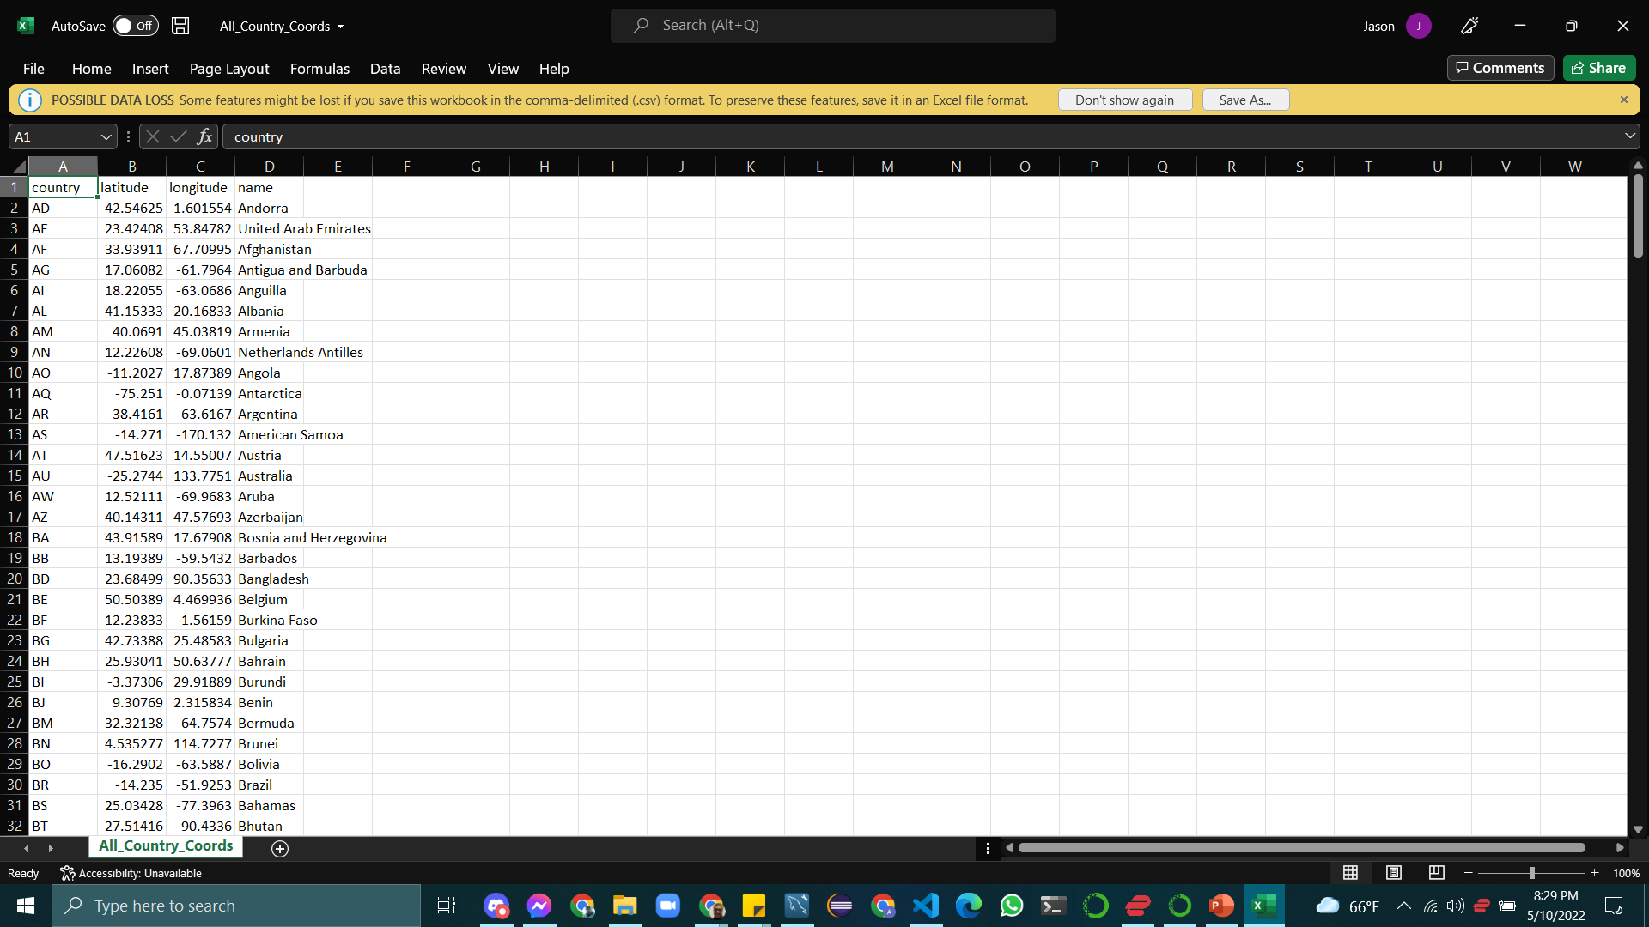
Country Location – Google Developers
This dataset was composed of:
245 rows
And 4 Attributes, notable ones include:
Country
Latitude
Longitude
Name

Slide 10
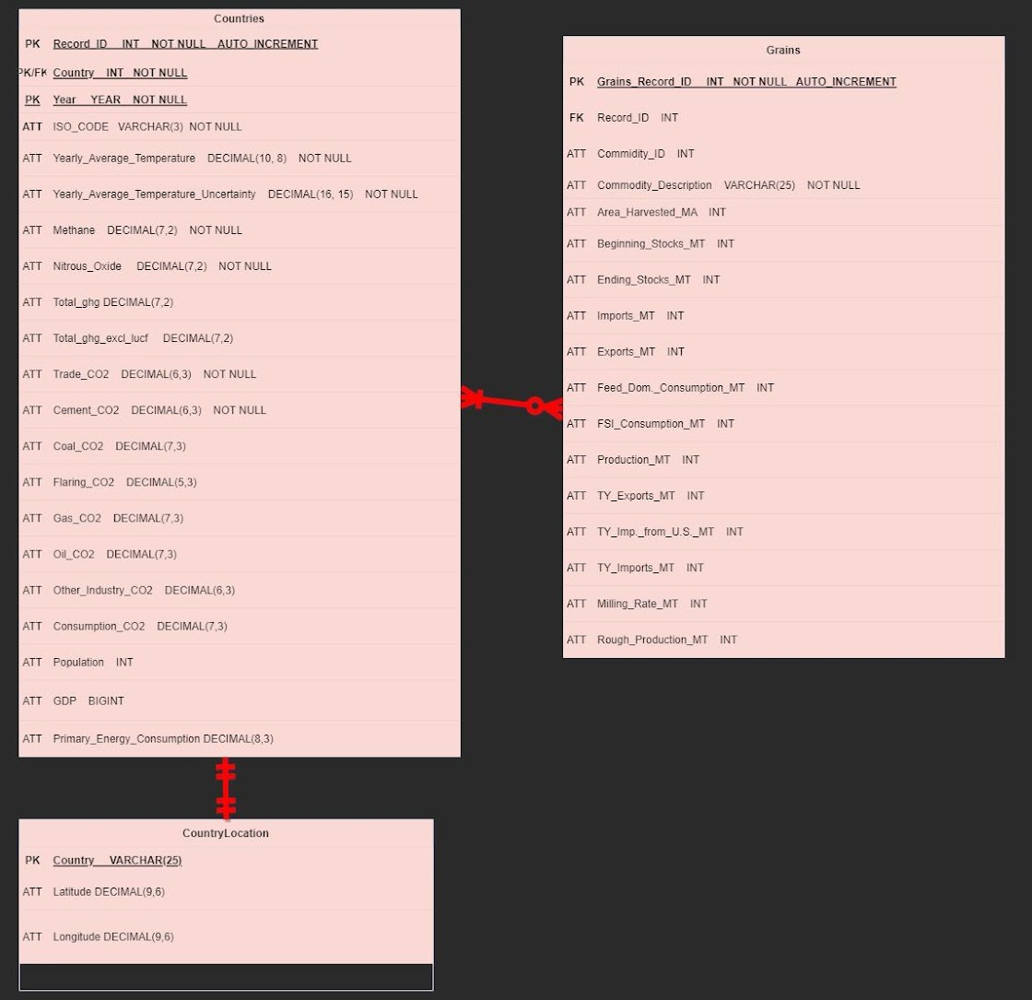
Relation Database Creation
Giving our Data Structure
Arranging the data into a Relational Database allowed us to integrate the 4 datasets together through Joins.
Having a MySQL database also allowed us to conveniently query data as needed.

Slide 11
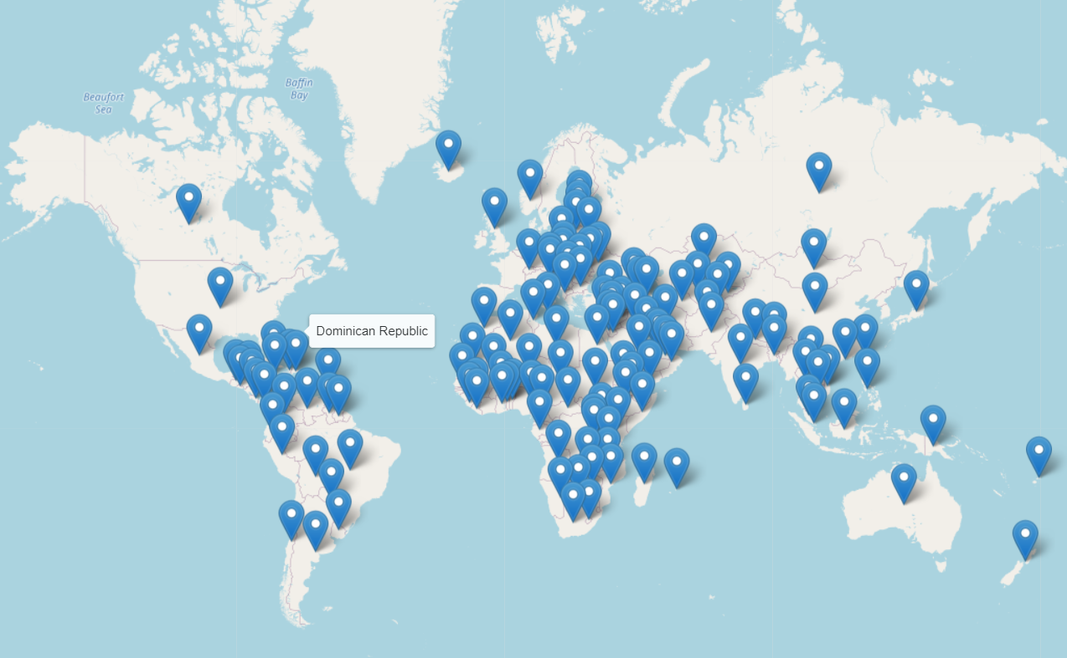
Where are we?
In total we have data on 136 Countries spanning over 53 years!

Slide 12




Solution Process
Model Comparison & Validation
Compare models and their metrics
STEP
04
Model Preparation
Ensure model gets correct input format
Normalization, Train/Test Split, etc.
STEP
03
Model Selection
Unsupervised ML – Clustering & Tree
Supervised ML – Regression Analysis
STEP
02
Data Wrangling
Missing Values Treatment, Creating new variables
STEP
01

Slide 13
Data Wrangling
The “Our World in Data – CO2 Emissions” dataset had been missing quite a lot of values for multiple different attributes
We used KNN in order to predict which values to impute into the dataset, since values like mean or mode wouldn’t be reliable for the nature of the data.
Summed the different sources of CO2 emissions into a “Total CO2” features

Slide 14
Model Selection & Pre-processing
Unsupervised ML – Clustering & Decision Tree
Normalization for numerical data
One-Hot-Encoding for categorical data
Supervised ML – Regression Analysis
Test/Train Splits for Regression analysis
Used Recursive Feature Elimination (RFE) to select best features

Slide 15
Cluster Model Comparisons - Metrics
K-Means
DBSCAN
Hierarchical
(Agglomerative)
Silhouette Score | Number of Clusters
0.36 | 3
0.48 | 4
0.66 | 16
0.70 | 8
Silhouette Score | Number of Clusters
0.714 | 45
0.752 | 18
0.747 | 23
0.746 | 16
Silhouette Score | Number of Clusters
0.263 | 4
0.38 | 5
0.746 | 16
0.74 | 10
Default Parameters
Tuning Attempt 1
Tuning Attempt 2
Optimal Results

Slide 16
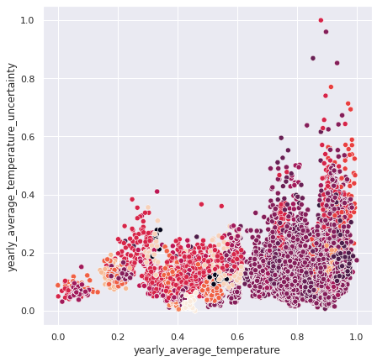
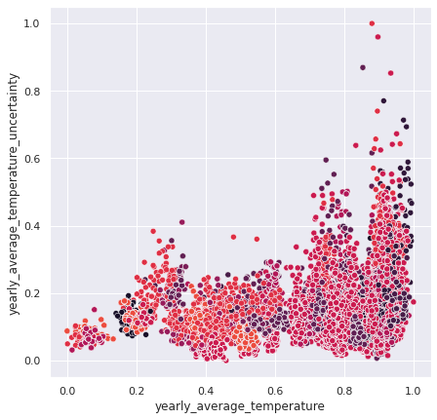
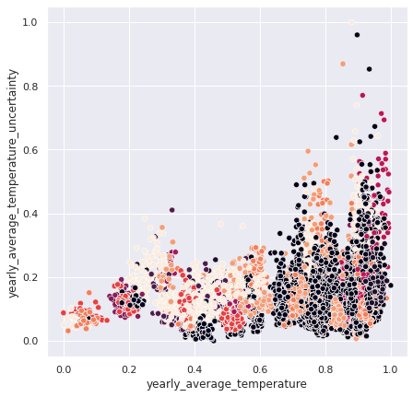
Cluster Model Comparisons – Visual: 16 Clusters
KMeans
DBSCAN
Agglomerative

Slide 17
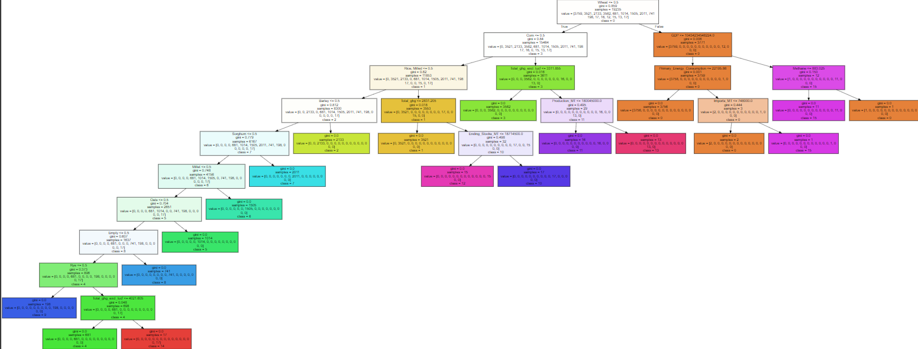
Cluster Model Interpretation

Slide 18
Regression Model Comparisons
Multiple Linear Regression
(2 Features)
Simple Linear Regression
Random Forest Regression
RMSE | R²
0.02 | 0.33
0.002 | 0.99
0.006 | 0.54
0.01 | 0.89
RMSE | Adj. R²
0.01 | 0.88
0.002 | 0.99
0.003 | 0.87
0.009 | 0.94
RMSE | R²
0.003 | 0.98
0.001 | 0.99
0.001 | 0.96
0.004 | 0.98
Cluster 0 (Wheat)
Cluster 1 (Rice)
Cluster 2 (Barley)
Cluster 3 (Corn)

Slide 19
Demo

Slide 20





Key Insights
The most important factors that influence the problem
Grain Type
Temperatures
Population
Total CO2
GDP

Slide 21
Conclusion & Suggestions
Initial Hypothesis: Poor countries are at risk of food shortages if Climate Change stays on track.
Countries with lower GDP values tended to produce less grains and import more of their food.
Green Energy
Giving poor countries sustainable & clean energy
for advancement.
Green Diet
Moving towards a green diet offers both sustainability and less green house gas emissions.
Notes:
Hypothesis: If Climate Change is not properly addressed then poorer countries will be at risk due to over reliance on technologically advanced countries for food.

Slide 22
Challenges & Setbacks
Initial planning and communication:
Struggled with consistent communication and team coordination.
Unfamiliarity with understanding and interpreting pure unsupervised clustering
This was our first Data Science Project with messy raw data from start to finish.

Slide 23

Improvement 1
Improvement 2
Improvement 3
Potential Improvements
Properly determining a scheduled meet time. Implement AGILE methods.
Potentially expand from Country to City to get more precise data.
Implement association mining using clusters as bins.

Slide 24
References
Research Sources
Eze, U. (2020, September 6). Predicting weather temperature change using machine learning models. Medium. Retrieved May 10, 2022, from https://medium.com/swlh/predicting-weather-temperature-change-using-machine-learning-models-4f98c8983d08
Food and Agriculture Organization of the United Nations. (n.d.). Macroeconomy. Retrieved from https://www.fao.org/3/i2490e/i2490e01c.pdf
Gray, E. (2021, December 2). Global climate change impact on crops expected within 10 years, NASA study finds – climate change: Vital signs of the planet. NASA. Retrieved May 10, 2022, from https://climate.nasa.gov/news/3124/global-climate-change-impact-on-crops-expected-within-10-years-nasa-study-finds/
Hille, K. (2016, May 3). Rising carbon dioxide levels will help and hurt crops. NASA. Retrieved May 10, 2022, from https://www.nasa.gov/feature/goddard/2016/nasa-study-rising-carbon-dioxide-levels-will-help-and-hurt-crops
Kumar, V. (n.d.). What is K-Means Algorithm and how it works. Towards Machine Learning. Retrieved May 10, 2022, from https://towardsmachinelearning.org/k-means/?msclkid=683a1a1ace7d11ec8481b4641adc09a4
KumarI, A. (2022, March 10). Machine learning use cases for climate change. Data Analytics. Retrieved May 10, 2022, from https://vitalflux.com/machine-learning-use-cases-climate-change/
Ritchie, H., Roser, M., & Rosado, P. (2020, May 11). CO2 emissions. Our World in Data. Retrieved May 10, 2022, from https://ourworldindata.org/co2-emissions
USDA. (n.d.). PSD Online. Retrieved May 10, 2022, from https://apps.fas.usda.gov/psdonline/
Dataset Sources
https://github.com/owid/co2-data
co2-data/owid-co2-codebook.csv at master · owid/co2-data (github.com) - Codebook for dataset
https://www.kaggle.com/berkeleyearth/climate-change-earth-surface-temperature-data
https://apps.fas.usda.gov/psdonline/downloads/psd_alldata_csv.zip - Full Agriculture
https://apps.fas.usda.gov/psdonline/downloads/psd_grains_pulses_csv.zip - Grains Agriculture
countries.csv | Dataset Publishing Language | Google Developers - Latitude/Longitude Data

Slide 25
QA?

